Slide 1
Replicator Easy GP Macro Replication -WITHOUT Mail Merge
File Version: 9.27.18

Slide 2
John Arnold
US Digital Corporation
Senior Software Engineer
GP Administrator
Day to day operations
Customizations (C#, SQL, Modifier, VBA, SSRS, Crystal Reports…)
In-House C# / SQL Applications
Interfaces with GP Database (Get Customers, Items, BOMs, MOs…)
Standalone Databases

Slide 3
Perform Mass Updates with GP Macros
What is a GP Macro?
Use a Macro to Perform Mass Updates
Run Macro for Record A
Run Macro for Record B
Run Macro for Record C
Rinse & Repeat
The Word Mail Merge solution has been used for years but Replicator simplifies the process!

Slide 4
Word Mail Merge Issues
Things to Remember
What type of Mail Merge should I be using?
Select the correct range for the source data
Source file is locked
Save File As text → File.mac
Header lines vs repeating lines
Quotes – Word gives you ‘ or ’ when you need '
Many steps… I can't remember what I don’t remember…
Notes:
Types: Letters, E-mails messages, Envelopes, Labels or Directory
Range – What range in Excel?
I CAN SIMPLIFY THIS!!!
This is why I create Replicator.xlsm

Slide 5
Replicator – Mass Updates to GP Data
GP Macro + Data → Replicated Macro
GP Macro
Macro
Replicated
N Times
Replicator
N Data
Records

Slide 6
Replicator.xlsm
First Look
Notes:
Here’s a quick glance at Replicator

Slide 7
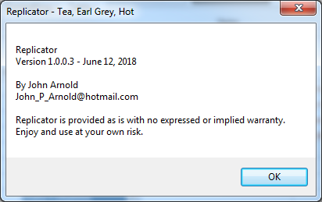
Replicator.xlsm
Get the latest
Visit Rnoldz.com/replicator for the latest version

Slide 8
Task - Fix Addresses Uppercase Addresses
Notes:
We’ve been tasked to clean up all customer addresses by capitalizing the Address 1 & Address 2 fields. A pretty simple example…

Slide 9
Uppercase Addresses
Required Steps:
Open Customer Maintenance window
Load Customer
Capitalize Address 1 and Address 2 fields
Save Customer
Load Next Customer
Rinse and Repeat…
Notes:
These are the basic steps needed to accomplish the task

Slide 10
Record The Macro
Notes:
*** Fix one record and record UpdateAddress.mac in GP ***

Slide 11
Demo – Capitalize Customer’s Address
Record the Macro
Run GP
Start recording macro (Alt+F8) and enter macro file name (UpdateCustomerAddress.mac)
Open Customer Maintenance window
Enter Customer ID
Enter Address 1
Enter Address 2
Save customer
Stop recording macro (Alt+F8)
Notes:
This is a more detailed description of what has to be done in GP to accomplish the task
**** Go to GP and record the macro ****
Save as UpdateCustomerAddress.mac

Slide 12
Capitalize Customer’s Address Macro
UpdateCustomerAddress.mac file viewed in Notepad
Notes:
The actual steps were recorded in GP to make this macro

Slide 13
Macro Overview
Macro File Contents
Viewed in Notepad++ with custom User Defined Language
Comment Line
Everything after the # is a comment and is ignored by GP.
Load Customer
Enter Customer Number and Tab off of the field to load it.
Note
These are Header Lines
Save the Customer
This is different when using Action Pane vs Menu Bar Window Display Command.
Customer Maintenance
Open Customer Maintenance window from the Cards Menu.
Update Addresses
Move to each Address field and enter the new value.
Notes:
Viewed in Notepad++ with GP Macro.xml language file
GP Macro.xml available at Rnoldz.com/replicator

Slide 14
The Data Export SmartList to Excel
Notes:
**** GOTO GP ***
Export SmartList, Convert To Table, Add Upper 1 & Upper 2,
Name Table, Save as Addresses.xls

Slide 15
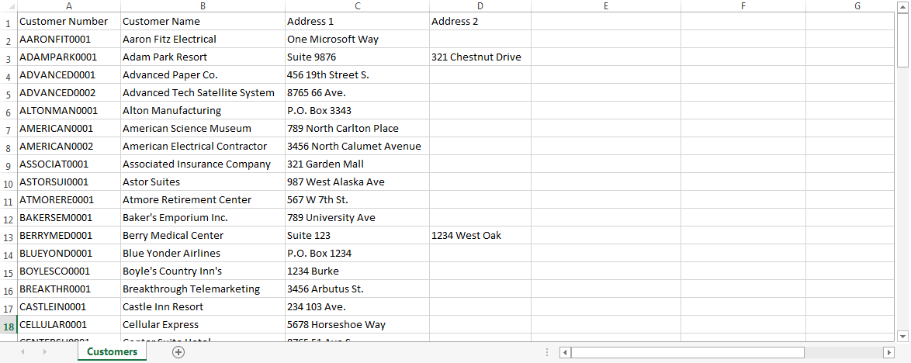
Export Customers SmartList to Excel

Slide 16
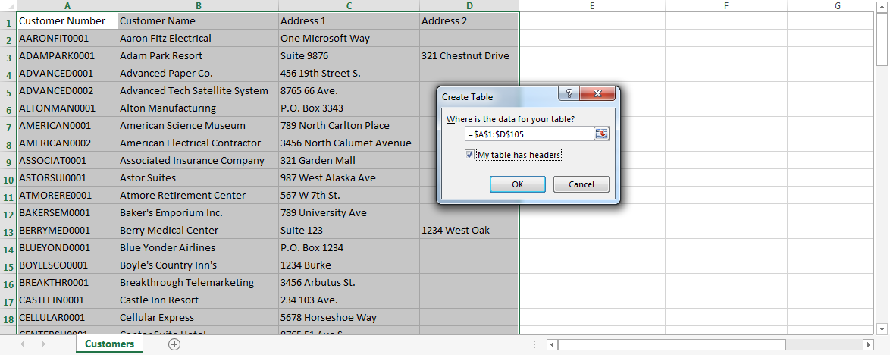
Convert Data Range into a Table
Create Table
Highlight Data (Ctrl+A)
Insert Table (Ctrl+T)

Slide 17
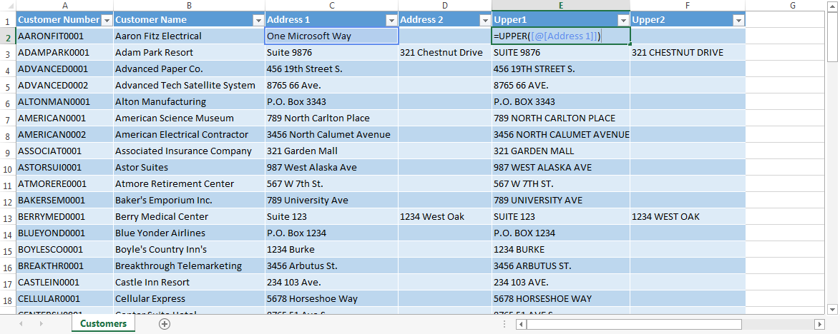
Uppercase the Addresses
New Columns & Formulas
Upper1 into cell E1
=UPPER([@[Address 1]] into cell E2
Upper2 into cell F1
=UPPER([@[Address 2]] into cell F2
Save As Addresses.xlsx
Notes:
**** Go to GP and Export SmartList to Excel ****
Tables are AWESOME!!! Auto adds Rows & Columns…
Add Upper1 & Upper2 Columns
Tables are AWESOME!!! Formulas get copied to all lines
Add Formulas

Slide 18
Replicator in Detail Combine the Data and Macro

Slide 19
Replicator Overview
Command Buttons
Export Options
Macro Table
Replace DataTable Button
DataTable
Notes:
We’ve got the data, we’ve recorded the Macro, Let’s join them in Replicator
*** Do it in Excel ***

Slide 20
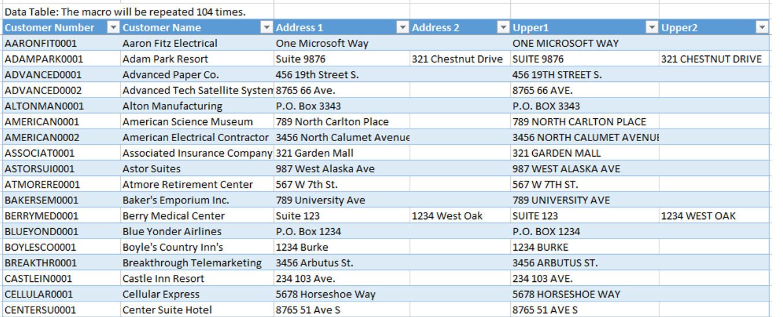
DataTable – The keys and new data
Data Sources
Manually Entered
SmartList Export
Excel Refreshable Report
Notes:
The Source Data is from the Addresses.xlsx file we just created
Copy and Paste can rename the DataTable breaking Replicator.xlsm

Slide 21
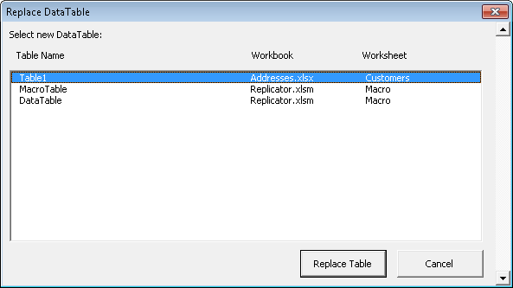
DataTable
Copy Table from another Workbook
The ReplaceData Table button copies a Table from an open workbook into the DataTable
Open Addresses.xlsx
From Replicator, press the Replace DataTable
button
Select Table1 from Addresses.xlsx
Choose the Replace Table button
Refreshable Reports can be copied this way!
Warning: Cut/Copy and Paste will rename
the DataTable, breaking Replicator!
Notes:
**** Go to Replicator and demo ReplaceData ****

Slide 22
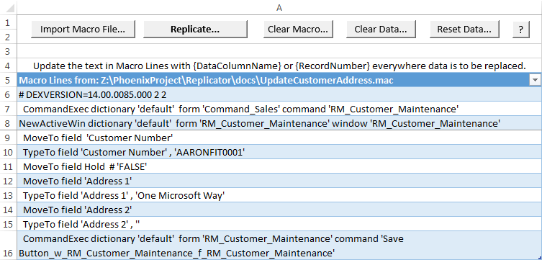
MacroTable
Import Macro File…
Select UpdateCustomerAddress.mac
Notes:
Getting your Macro into Replicator
**** Go to Replicator and Import the Macro File…

Slide 23
Link the Data to the Macro
Update the Macro with {DataColumnName}
This is similar to entering a mail merge field into a Word document.
Note: The {DataColumnName} must match the Column Name Exactly!
Excel Tip: Use F2 to edit cell data
TypeTo field 'Customer Number' , 'AARONFIT0001'
TypeTo field 'Customer Number' , '{Customer Number}'
TypeTo field 'Address 1' , 'One Microsoft Way'
TypeTo field 'Address 1' , '{Upper1}'
TypeTo field 'Address 2' , ''
TypeTo field 'Address 2' , '{Upper2}'

Slide 24
Header Rows
The first three rows of the Macro are Header Rows
In the Export Options area, set the Header Rows value to 3
The Gold Header Rows will only be written to new macro file once

Slide 25
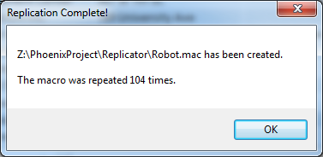
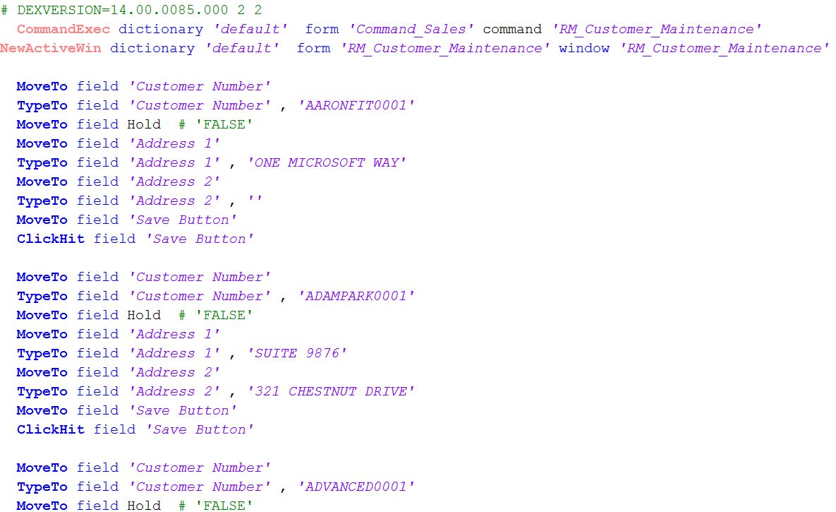
Replicate Button… Show me the magic!
Notes:
**** Go to Replicator ****
Update Data Table
Set Header Rows
Replicate
Run Macro in GP
**** Cause it to abort ****

Slide 26
Warning! There is no Undo!

Slide 27
Warning – BE SAFE!
Running a macro is permanent!
There is no Undo
Run in Test environment
Backup your databases
Start with small data sets
Don’t do anything while the macro is running
Test, Test, Test!

Slide 28
Reusable Refreshable Report

Slide 29
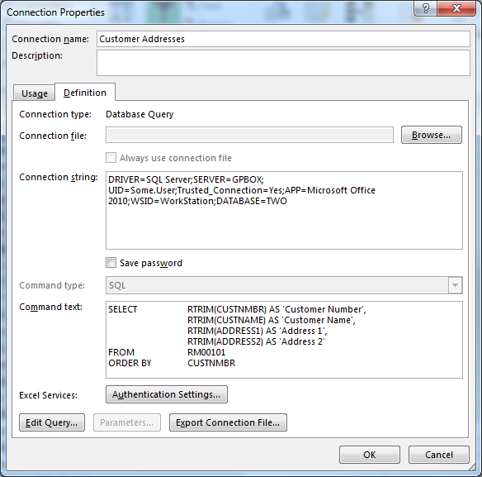
Create Addresses Refreshable Report
Read Directly from GP Customer Table
Notes:
Use Stored Procedures!!!

Slide 30
Name the Table
Rename Table to AddressRefreshableTable
Click on a cell in the table
Click on DESIGN tab
Enter AddressesRefreshableTable in the Table Name field

Slide 31
Replace the DataTable
Use the AddressRefreshableTable as the new DataTable
In Replicator.xlsm, Press the “Replace DataTable” button
Select AddressRefreshableTable
Recreate the Upper1 column =UPPER([@[Address 1]])
Recreate the Upper2 column =UPPER([@[Address 2]])
A copy of the refreshable report table is now in Replicator.xlsm. The original report can be discarded.
Notes:
**** Go to Replicator in Excel ****
Open Addresses Refreshable.xlsx
Replace the DataTable from Addresses Refresable.xlsx
Change data in GP & Refresh Data in Replicator

Slide 32
Filter Column Only Update Data When Needed

Slide 33
Filter Column
Allows you to specify if a row of data should be included when the macro file is generated.
Add a new column named Update to the DataTable
Set the first row of the Update column to the formula =FALSE
Set the first two rows of the Update column to the constant TRUE
Choose Update from the Filter Column list

Slide 34
Filter Column (continued)
The Filter Column has been Selected
The Update column has been Added
The new repeat count has been calculated.
Notes:
**** Goto to Excel ****
Add Update Column
Select Update Column as Filter

Slide 35
Smart Filter Column
Use a formula to determine what needs to be updated
The formula should return TRUE when (Address 1 is different than Upper1) or (Address 2 is different than Upper2)

Slide 36
Smart Filter Column – Fun with Excel
Excel Functions:
AND(E1,E2,…) returns TRUE if all of the parameters (E1,E2…) are TRUE
NOT(E1) returns the inverted value of E1. NOT() returns FALSE if E1 is TRUE otherwise it returns FALSE
EXACT(S1,S2) returns TRUE if S1 and S2 are the exact same string – This is a Case Sensitive string comparison. Excel’s normal string comparisons are case insensitive. “a” = “A” is TRUE while EXACT(“a”, “A”) returns FALSE.

Slide 37
Smart Filter Column – Update Column
Compare only Address 1 to Upper1
=EXACT([@[Address 1]],[@Upper1]) returns FALSE when Address 1 <> Upper1
=NOT(EXACT([@[Address 1]],[@Upper1])) returns TRUE when Address 1 <> Upper1
Compare Address 1 to Upper1 & Address 2 to Upper2
=NOT(AND(EXACT([@[Address 1]], [@Upper1]), EXACT([@[Address 2]],[@Upper2]))) returns TRUE if Address 1 <> Upper 1 or Address 2 <> Upper2
Note: This example is for demonstration purposes only. The query returning the data should only return rows where the addresses are different to reduce the number of rows returned to Excel.
Notes:
**** Goto Excel ****
Add Upper1 & Upper2 and Update Columns
Set Column Filter
Note addresses that haven’t been update because of the earlier failure
Replicate Macro
Look at mac file in Notepad++

Slide 38
RecordNumber

Slide 39
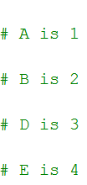
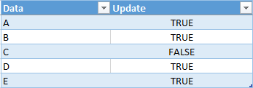
{RecordNumber} Introduction
{RecordNumber} is replaced with the current record number.
{RecordNumber} does not change when a data row is filtered out.
Example Macro & Data:
Example Output:

Slide 40
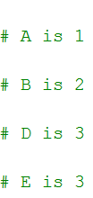
{Max RecordNumber}
When {Max RecordNumber} is blank, the {RecordNumber} keeps incrementing for every record.
When {Max RecordNumber} has a value, the {RecordNumber} keeps incrementing until it reaches the specified value.
Example Macro & Data:
Example Output:

Slide 41
Scrolling Windows

Slide 42
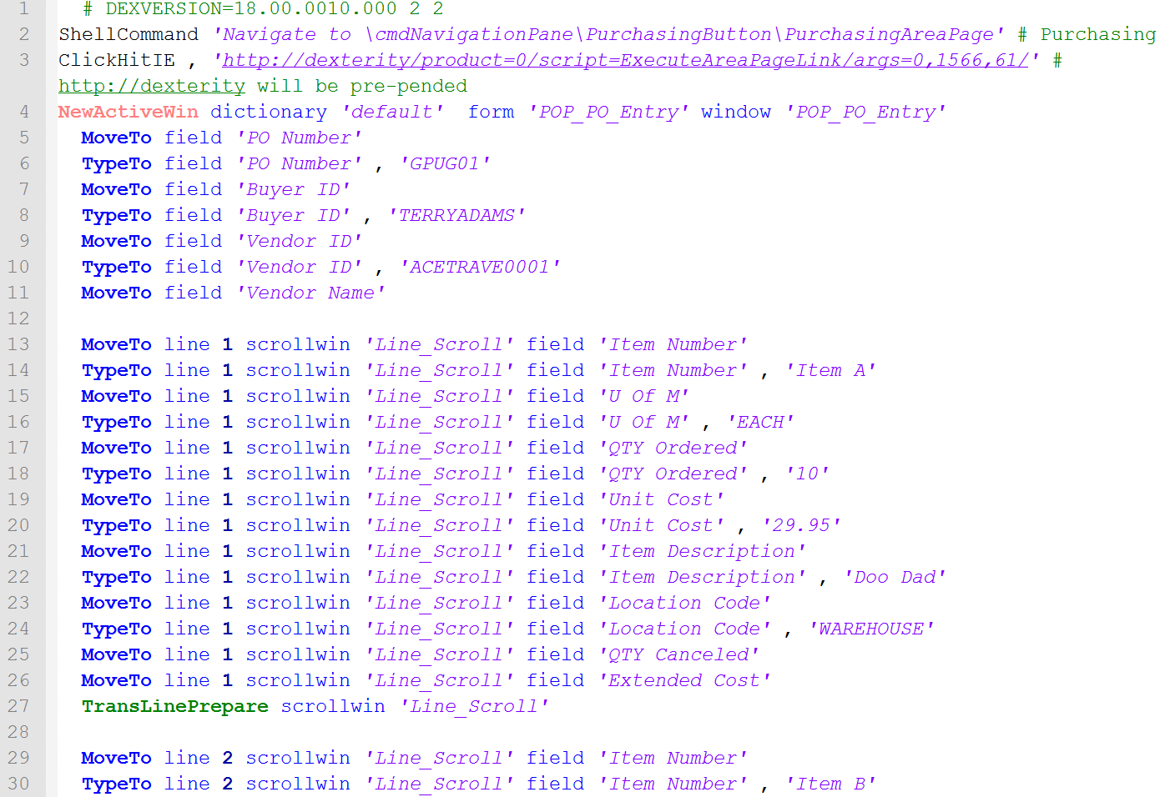
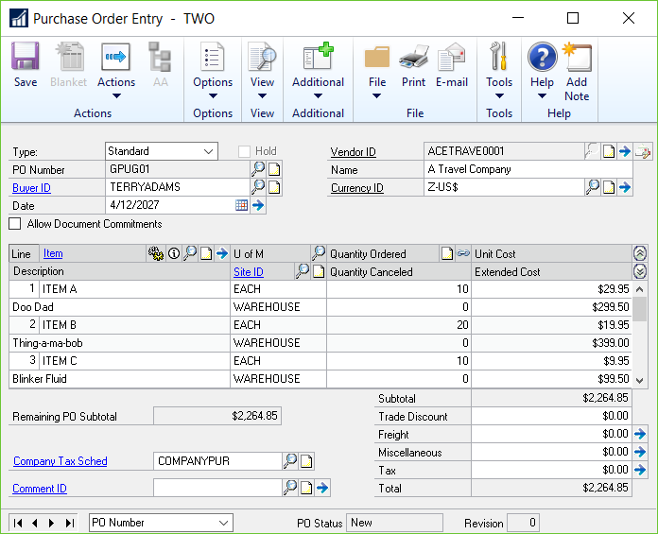
Scrolling Windows
The “line” increments as lines are entered

Slide 43
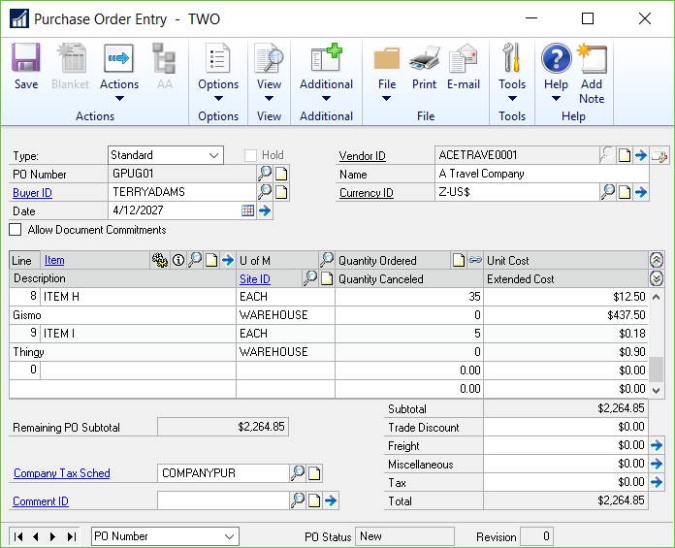
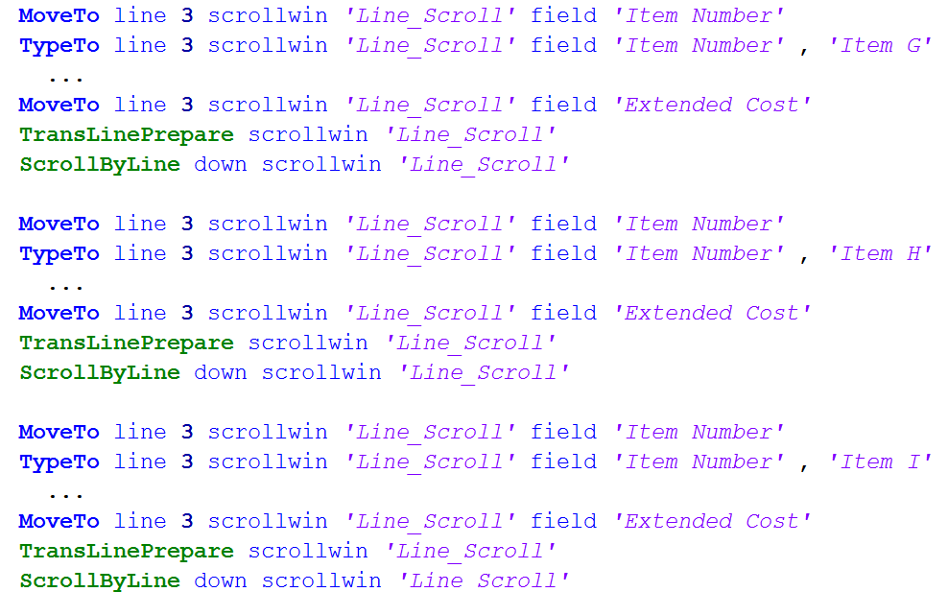
Scrolling Windows
As more lines are entered, the “line” stays at 3 as the window scrolls (ScrollByLine is added)

Slide 44
Scrolling Windows
Use {RecordNumber} for the “line” in Scrolling Windows
Set {Max RecordNumber} to the # of Scrolling Lines
For example:
3 for Purchase Orders
8 for Sales Orders

Slide 45
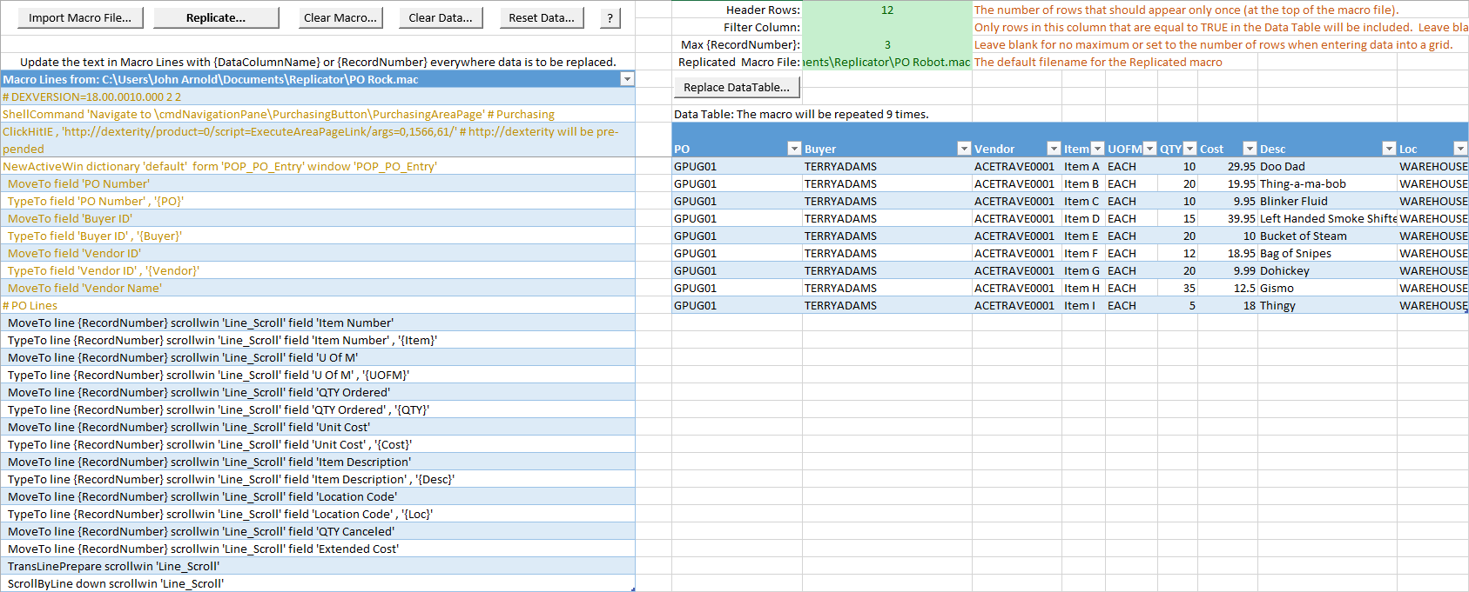
{RecordNumber} & Scrolling Windows

Slide 46
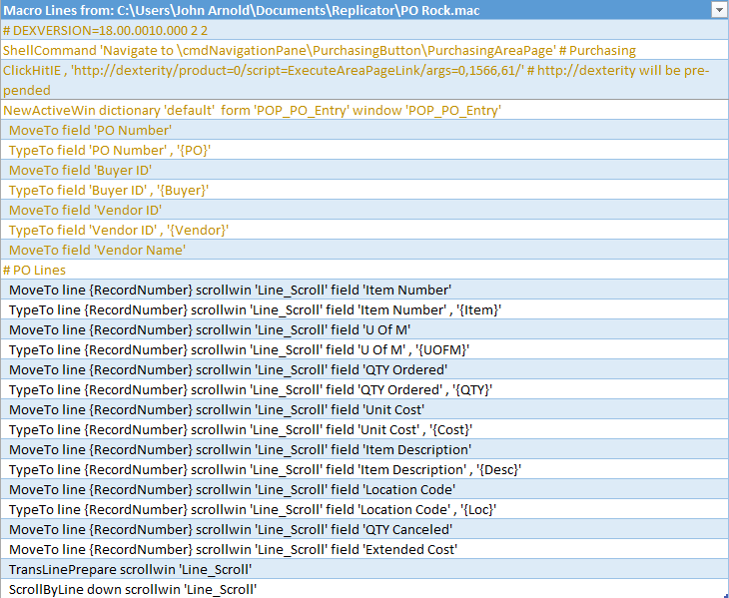
{RecordNumber} & Scrolling Windows
Line Scroll
TransLinePrepare
ScrollByLine – Added manually!
{Record Number}
The PO Entry grid displays three line items
Column Headers
Simple {column names} to be inserted into the macro
Data for Macro Header Lines
Only the data from the first row will be used in the header
Header Rows
12 for this macro
Notes:
**** After Animation - Goto Excel - Purchase Order Replicator ****
Replicate…
**** Run macro in GP ****

Slide 47
Notes and References

Slide 48
Notes
Warnings
Develop in Test Environment
Don’t do anything while the macro is running
Advanced
Use Excel Macro to programmatically add GP Macro functionality
Future Versions & Feature Requests
Macro Line Type – Header, Data, Footer Flag
Requests and ideas – Please email me!!!

Slide 49
References
Replicator Files
Replicator Excel file: Rnoldz.com/replicator/Replicator.xlsm
GP Macro language file for Notepad++: GP Macro.xml
Leslie Vail’s “Speed up your macros” Post. A simple dex.ini setting that will increase the speed of your macros. http://dynamicsconfessions.blogspot.com/2014/07/speed-up-your-macros.html
Search GPUG for information about Excel Refreshable Reports. As of June, 2018, there were over 18,000 posts.
Notepad++ free text editor: https://notepad-plus-plus.org/
Notes:
Macro Speed - 55 seconds down to 35 seconds.

Slide 50
Q & A

Slide 51
Thank You!
John Arnold
John_P_Arnold@hotmail.com
Latest files can be found at Rnoldz.com/replicator
Version: 2018.10.16

