Slide 1
Let Macros in Dynamics GP be your Superpower for Repetitive Tasks and Mass Updates
John Arnold
Senior Software Engineer
US Digital
Rev 2022100513
Notes:
Mix between an overview and a tutorial

Slide 2
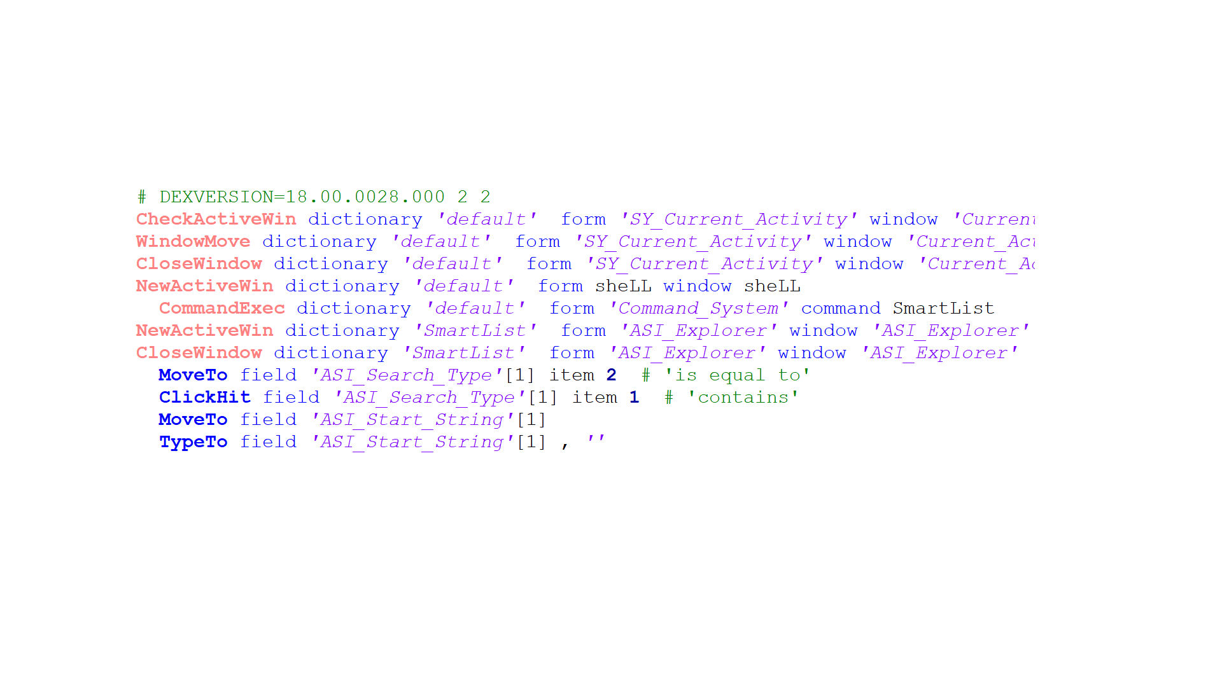
GP Macros
Let Macros in Dynamics GP be your Superpower for Repetitive Tasks and Mass Updates
John Arnold
Senior Software Engineer
US Digital

Slide 3
Introduction to Macros
A Macro File’s Contents
Replicator & Mass Updates
Tips, Tricks & Avoiding Pitfalls
References
Summary

Slide 4
Introduction to Macros

Slide 5
Introduction to Macros
A GP Macro is a text file that contains instructions for GP
Open window Move to a field Enter text
Click a button Close window
“Almost” everything in GP can be done by Macros, Except
Selecting items from lists can be difficult
Printer Options (System Dialogs) can’t be set
The main GP window cannot be moved

Slide 6
Macro Example – Position SmartList
When GP starts, our shipping department wants to
Open a Shipping SmartList
Move the Shipping SmartList to bottom of screen
Set the width of the Shipping SmartList
Create the Macro
Tell GP to Record a Macro
Open and Position the SmartList
Stop the Recording

Slide 7
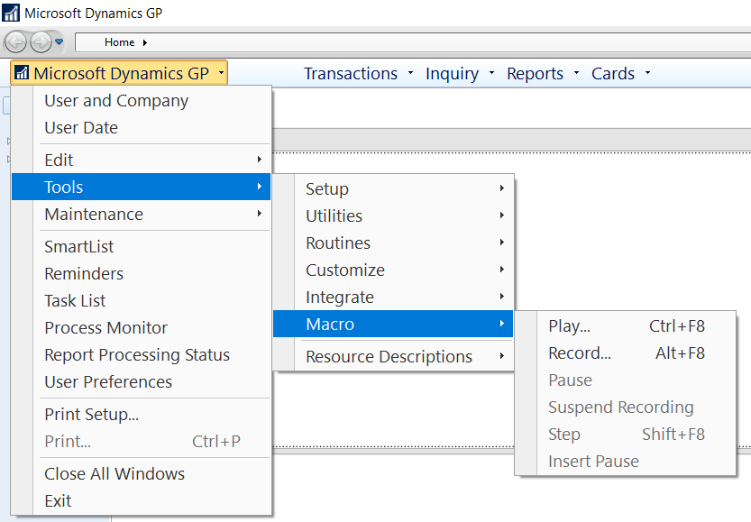
Macro Example – Position SmartList
Macro Menu
Main Dynamics GP Menu
Tools Menu on Windows
Short Cut Keys
Ctrl+F8 – Playback Macro
Alt+F8 – Record Macro
Note: Control GP + F8
Demo

Slide 8
Demo Complete
Press Alt+F8 to Stop
Recording the Macro
Press Alt+F8 to Start
Recording the Macro

Slide 9
A Macro File’s Contents

Slide 10
Macro File’s Contents
A GP Macro is a text file that can be viewed/edited in any text editor (Not Word!)
Notepad
Notepad++ (with John Arnold’s GP Macro language file)

Slide 11
Macro File’s Contents in Detail
The MoveWindow.mac file has 199 lines
Here are some lines from the top, middle, and end

Slide 12
Macro File’s Contents – Top of File
# - Comment Line - Everything following the # is ignored
CommandExec – Executes a Dexterity Command
NewActiveWin – Specifies which window to make active
WindowMove – Move the active window to the specified point
Note: Each function is described in HelpFile_Dex.chm

Slide 13
Macro File’s Contents – Middle of File
There 171 WindowMove and 22 WindowSize commands
Only the last move and size is needed
The new version only has eight lines

Slide 14
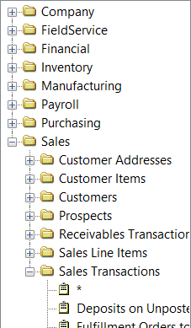
Macro File’s Contents – End of File
ItemExpand – Expand a node in tree view (SmartList)
ClickHit – Click on an item
The item # is the line number in the list (counting from the top of the list)
From a previous slide:
“Selecting items from lists can be difficult”

Slide 15
Macro File Contents – Auto-Start
Add Macro to Startup menu
Home Navigation Pane
Startup menu at top of Navigation Pane
Right click and Add Macro…
Note: If running Fabrikam company, SampleDataMsg=False must be added to DEX.INI for the Startup menu to work
Demo

Slide 16
Demo Complete

Slide 17
Replicator & Mass Updates

Slide 18
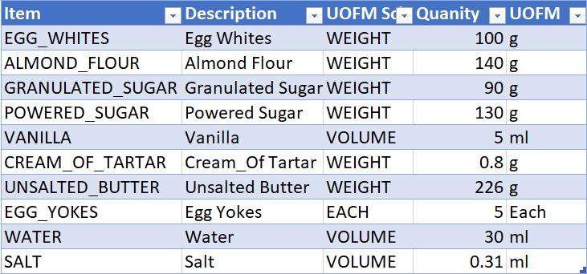
Mass Updates – Add Items
Task: Add these items to GP

Slide 19
Mass Updates – Add Items
Record a Macro and add one item to GP
Demo

Slide 20
Demo Complete
Press Alt+F8 to Stop
Recording the Macro
Press Alt+F8 to Start
Recording the Macro

Slide 21
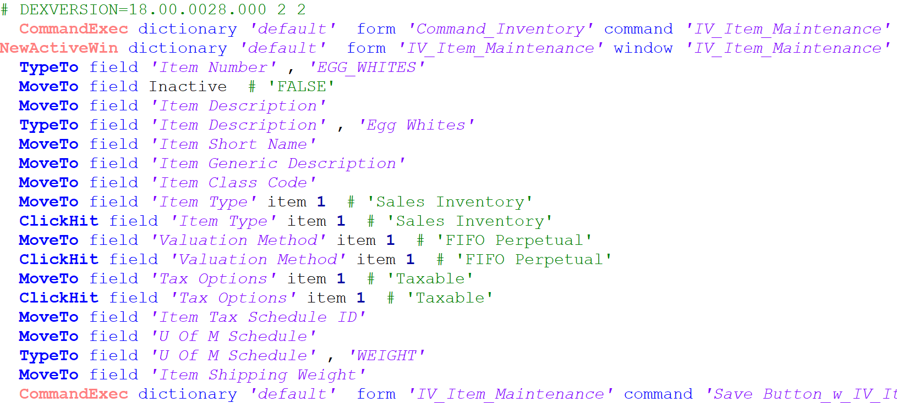
Mass Updates – Add Items
Macro Contents
If these lines are not needed, they can be deleted

Slide 22
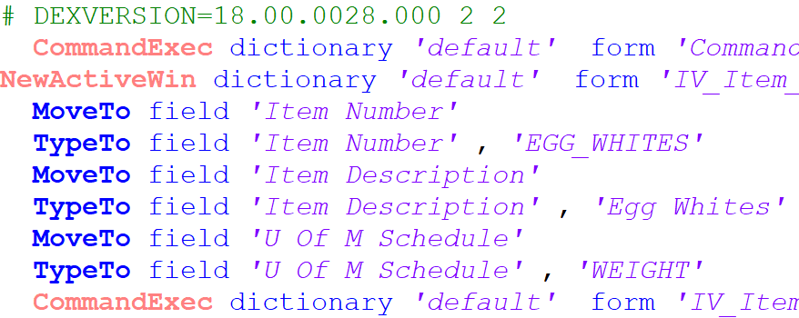
Mass Updates – Add Items
Macro Contents Edited
Open the Item Maintenance, do it only once

Slide 23
Mass Updates – Add Items
Macro Contents Edited
Manually add MoveTo command

Slide 24
Mass Updates – Add Items
Macro Contents Edited
Go to each field and enter data

Slide 25
Mass Updates – Add Items
Macro Contents Edited
Save the new Item

Slide 26
Mass Updates – Add Items
Macro Contents Edited
Repeat once for each data row/ingredient

Slide 27
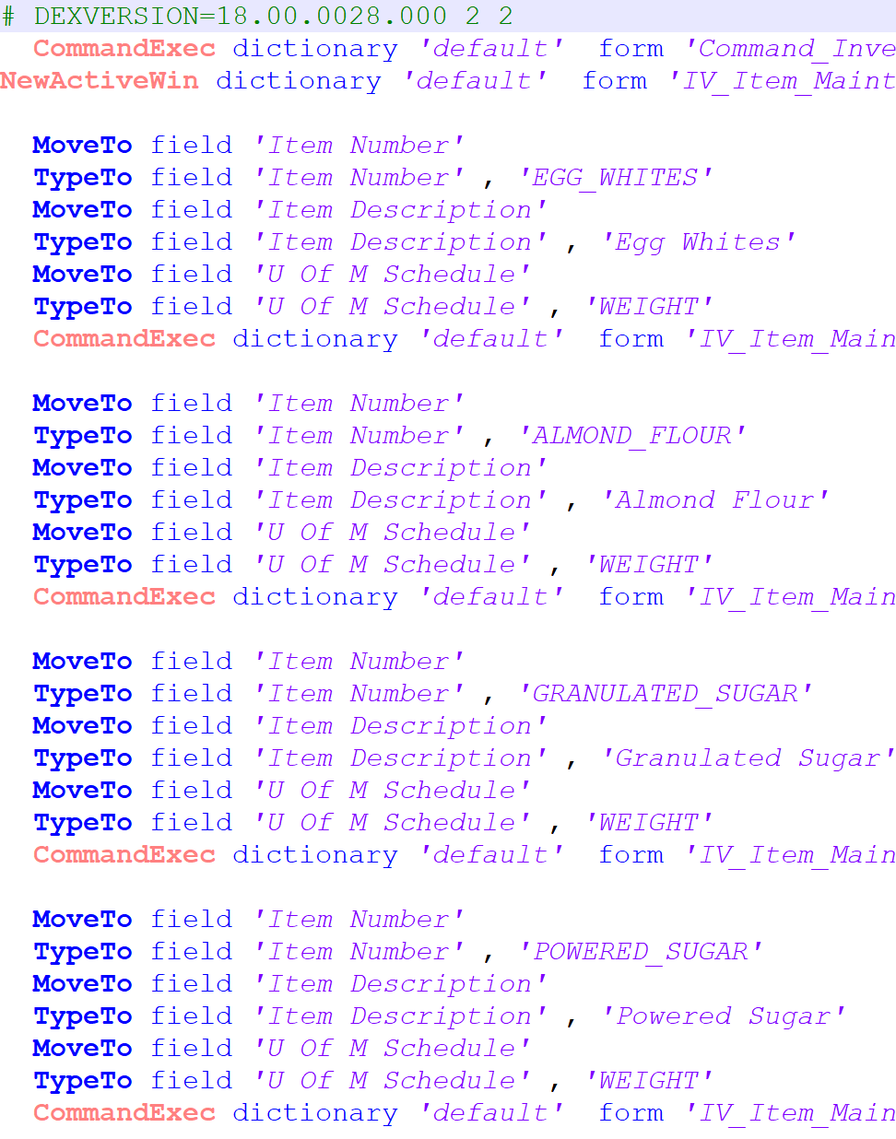
Merge Data Rows & Macro - Replicator
Data Rows
Replicator.xlsm
New Macro.mac
Macro

Slide 28
Mass Updates – Replicator Overview
Replicator.xlsm
Macro enabled (VBA) Excel workbook
Import macro in Replicator
List of data (Enter, Paste, SQL Query…) data
Link data fields into the Macro
Replicate to create new Macro file
Run new Macro file in GP

Slide 29
Replicator Introduction
Replicator’s Left Side – Macro information
Replicator’s Right Side – Data information

Slide 30
Replicator Introduction – Left Side
Import Macro - Import macro file into the Macro Lines table
Map Columns – Link the Data to the Macro
Replicate – Generate the Mass Update Macro file
Clear Macro – Clear the contents of the Macro Lines Table
? – Version and contact info about Replicator

Slide 31
Replicator Introduction
Replicator’s Left Side – Macro information
Replicator’s Right Side – Data information

Slide 32
Replicator Introduction – Right Side
Replicator Introduction
Header Lines: The number of lines that should appear once
Data Table Name: Optional – specify another table for data
Filter Column: Exclude Data Rows where this is not TRUE
Max {Record Number}: Used for Scrolling Windows
Replicated Macro File: Path\Name of Mass Update Macro file

Slide 33
Replicator Introduction – Right Side
Replicator Introduction
Replace Data Table: Easiest and safest way to import from a different table into the default Data Table
Clear Data: Remove all rows from the Data Table
Reset Data: Remove all rows and columns from the Data Table

Slide 34
Replicator – Link the Data to the Macro
Import Macro
Replace Data Table – Warning – Copy/Paste breaks things
Specify # of Header rows that should be repeated (Open window commands for example)
Create and Specify Filter – Don’t import EGG_WHITES again
Update Macro Text - Replace ‘Text’ with ‘{Column Name}’

Slide 35
Mass Updates – Add {Column Names}
Update Macro Text - replace ‘Text’ with ‘{Column Name}’
{Item}
{Description}
{UOFM Sched}
Warning – Smart Quotes (‘ ‘) vs Straight Quotes (' ')

Slide 36
Mass Updates – Add Items
Replicate!
Demo

Slide 37
Unblock Downloaded Replicator Excel File
Demo Complete
Press Ctrl+F8 to
Play the Macro

Slide 38
Tips, Tricks & Avoiding Pitfalls

Slide 39
Pitfalls – Decimal, Numbers and in GP
Numbers in GP – 10.00 for example
You can enter 10. and hit tab
You can enter 1000 and hit tab
10 is stored in Excel
The Macro will enter 10 and move to the next command
0.10 will end up in the field ☹
Create a QtyFormatted column in Excel: =TEXT(10, "0.00")
Link to the {QtyFormatted} in the Macro

Slide 40
Pitfalls
THERE IS NO UNDO! Use a Test Company & Test, Test, Test!
While a macro is running, DON’T touch mouse or keyboard
Be consistent in your macro naming – run the correct macro
Always record macros from the same “window” in GP
Action Pane vs Menu Bar
Macro commands are recorded differently
NOT interchangeable

Slide 41
Tips & Tricks
Excel refreshable reports/tables
FANTASTIC source of data for Replicator
Repeatable
“Expiring” Part Example
Use filter column to reduce # of rows while developing
Speed! Avoid opening and closing windows if possible
Replicator will “protect” any single quotes (') in the data

Slide 42
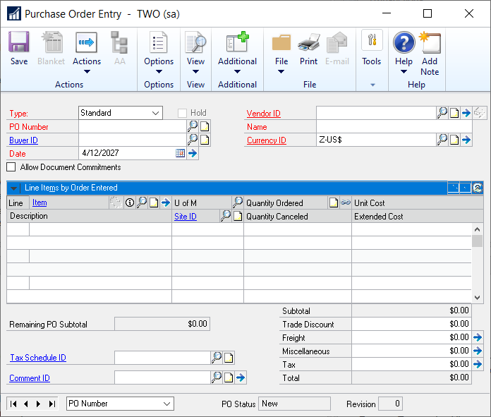
Tips & Tricks – Scrolling Windows
Scrolling Windows exist on many Windows in GP
Important Fields in Replicator
{RecordNumber}
Max {RecordNumber}

Slide 43
Tips & Tricks – Scrolling Window Take 2
Record the Creation of a new Purchase Order
Note: Include enough lines to cause the window to scroll
Demo

Slide 44
Tips & Tricks – PO Demo
Oops
Fabrikam
New Inventory Items
Can’t create PO before linking New Items to Vendor
Task – Link all new Items to the Vendor ACETRAVE0001
Demo
Each Item had to be linked to a site too – not shown in Demo

Slide 45
Demo Complete

Slide 46
Tips & Tricks – PO Demo
Task – Create new PO
Record Macro
Enter Header
Enter enough lines on the PO to cause scrolling
In the scroll window
Enter data on line 1, then line 2, and then line 3
Scroll the window up one line
Enter data on line 3 (again)
Rinse and repeat

Slide 47
Tips & Tricks – PO Demo Macro
Macro Header

Slide 48
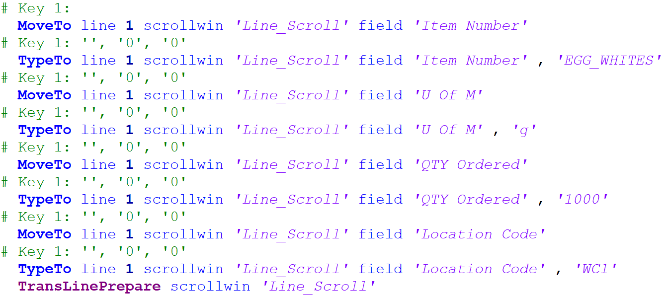
Tips & Tricks – PO Demo Macro
Macro Line 1
# Key – Comment Lines
Can be ignored

Slide 49
Tips & Tricks – PO Demo Macro
Macro Line 1
MoveTo – Same as before but now it includes the line #

Slide 50
Tips & Tricks – PO Demo Macro
Macro Line 1
TransLinePrepare – Get ready to move to the next line

Slide 51
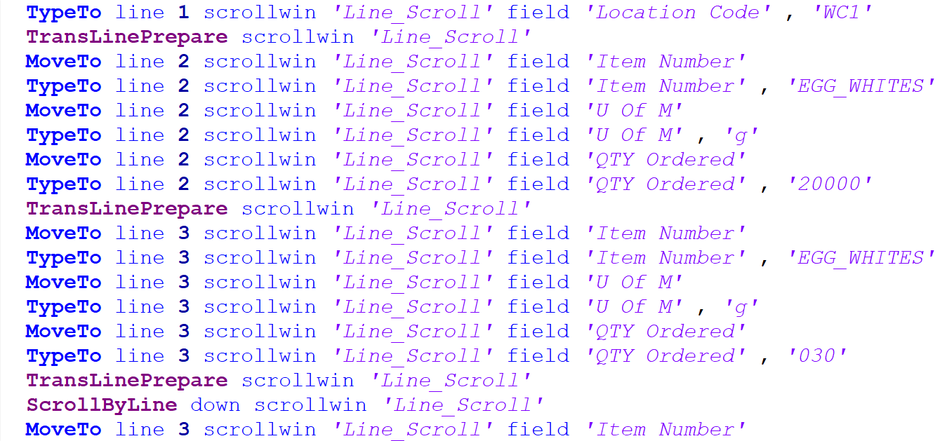
Tips & Tricks – PO Demo Macro
Macro Lines 1 - 4
First three lines, Add Data then TransLinePrepare

Slide 52
Tips & Tricks – PO Demo Macro
Macro Lines 1 - 4
After three lines, ScrollByLine to scroll the window

Slide 53
Tips & Tricks – PO Demo Macro
Macro Lines 1 - 4
Lines four and higher get entered onto line “3”

Slide 54
Demo Crashed

Slide 55
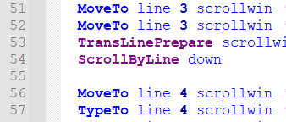
Tips & Tricks – PO Demo Crash
Macro Error: Field on window is inactive or disabled (Line #56)
PO Scrolling window only has three lines
Max {RecordNumber} in Replicator needs to be set to 3!

Slide 56
Demo Complete

Slide 57
References

Slide 58
References
HelpFile_Dex.chm – Reference to Macro commands
URL: https://learn.microsoft.com/en-us/dynamics/s-e/gp/mdgp2018_dexterityreleases_376
File: dx18.00.0015.zip
Notepad++ - Free text editor
URL: https://notepad-plus-plus.org
Rnoldz.com – John Arnold’s Website
Home of Replicator
A copy of this slide deck
Other GP related files

Slide 59
Questions

Slide 60
Thank you for Attending!
Please complete the surveys!
John_P_Arnold@hotmail.com
Senior Software Engineer
US Digital
Notes:
Mix between an overview and a tutorial

